Slide 1
Genetic disorder
Down syndrome
Presented by : Shreya, Pragnya, Rohit and Raunak

Slide 2
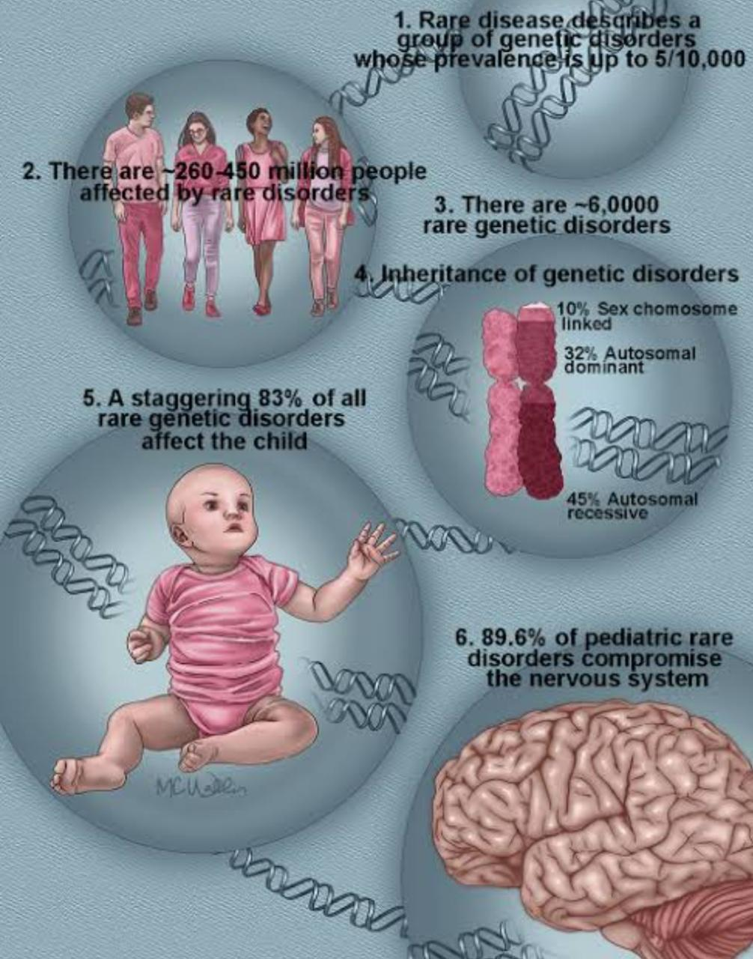
Genetic disorder
A genetic disorder is a disease caused in whole or in part by a change in the DNA sequence away from the normal sequence.

Slide 3
Genetic disorders can be caused by :-
a) Mutation in one gene (monogentic disorder)
b) Mutations in multiple genes (multifactorial inheritance disorder)
c) A combination of gene mutations and environmental factors
d) By damage to chromosomes (changes in the number or structure of entire chromosomes, the structures that carry genes).

Slide 4
Examples include:
Down Syndrome Thalassemia Cystic Fibrosis Tay-Sachs disease Sickle Cell Anemia

Slide 5
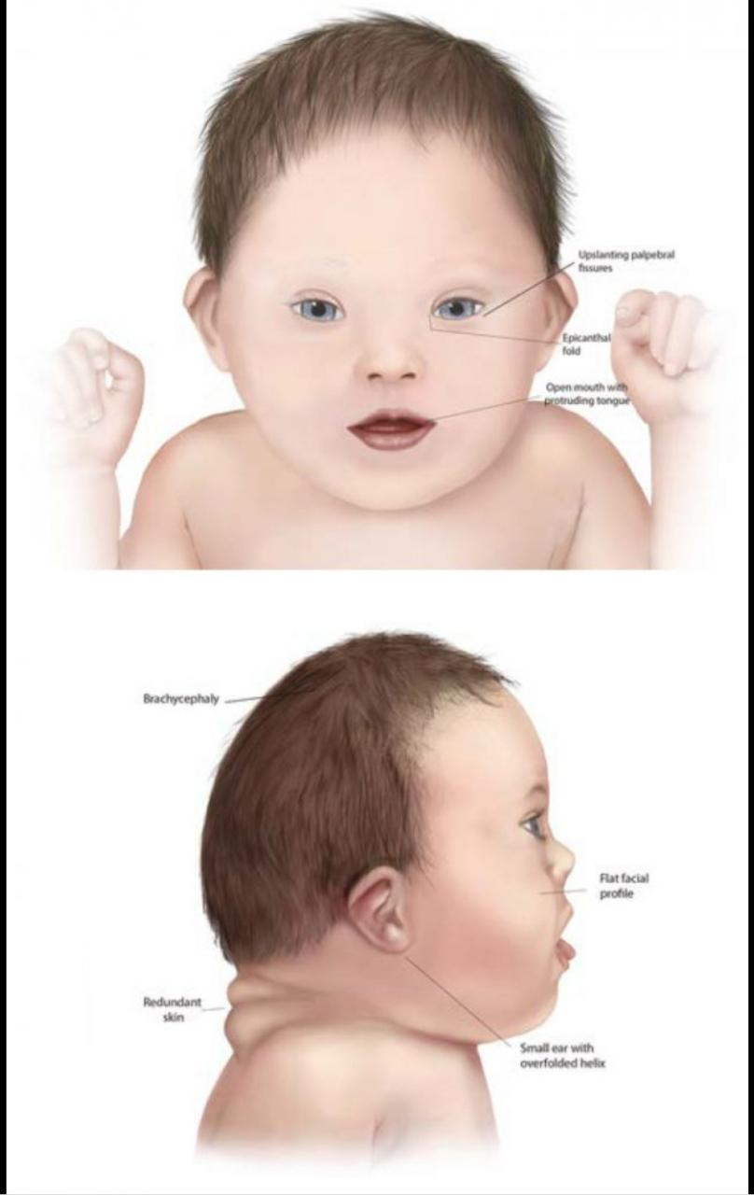
Down syndrome
Down syndrome is a genetic disorder caused when abnormal cell division results in an extra full or partial copy of chromosome 21. This extra genetic material causes the developmental changes and physical features of Down syndrome.

Slide 6
Down syndrome varies in severity among individuals, causing lifelong intellectual disability and developmental delays. It’s the most common genetic chromosomal disorder and cause of learning disabilities in children. It also commonly causes other medical abnormalities, including heart and gastrointestinal disorders.

Slide 7
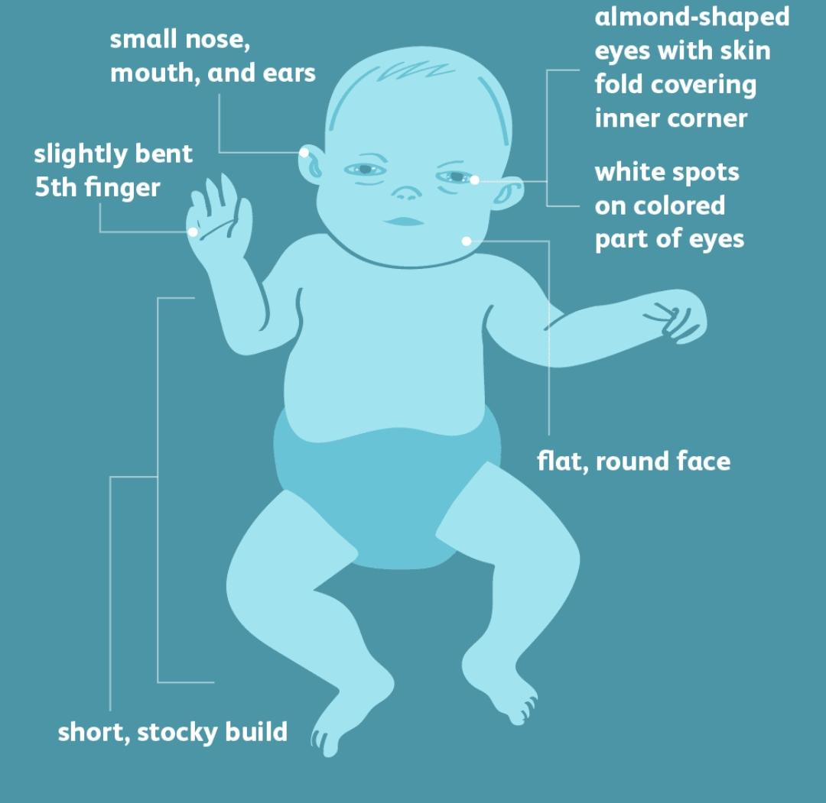
Symptoms
Flattened face Small head Short neck Protruding tongue Upward slanting eye lids (palpebral fissures) Unusually shaped or small ears Poor muscle tone Broad, short hands with a single crease in the palm Relatively short fingers and small hands and feet Excessive flexibility Tiny white spots on the colored part (iris) of the eye called Brushfield’s spots Short height

Slide 8
Intellectual disabilities
Most children with down have mild to moderate cognitive impairment. Language is delayed, and both short and long-term memory is affected.

Slide 9
Complications
People with Down syndrome can have a variety of complications, some of which become more prominent as they get older. These complications can include: Heart defects.
Gastrointestinal defects
Immune disorder
Sleep apnea
Obesity
Spinal problem

Slide 10
Causes
Human cells normally contain 23 pairs of chromosomes. One chromosome in each pair comes from the father, the other from the mother. Down syndrome results when abnormal cell division involving chromosome 21 occurs. These cell division abnormalities result in an extra partial or full chromosome 21. This extra genetic material is responsible for the characteristic features and developmental problems of Down syndrome. Any one of three genetic variations can cause Down syndrome: Trisomy 21, Mosaic Down syndrome and Translocation Down syndrome

Slide 11
Treatment
A variety of therapies can be used in early intervention programs and throughout a person's life to promote the greatest possible development, independence, and productivity. Some of these therapies are listed below.
Physical therapy
Speech-language therapy
Occupational therapy
Emotional and behavioural therapies

Slide 12
Prevention
There’s no way to prevent Down syndrome. If a woman is at high risk of having a child with Down syndrome or already have one child with Down syndrome, she may want to consult a genetic counsellor before becoming pregnant. A genetic counsellor can help to understand her chances of having a child with Down syndrome. He or she can also explain the prenatal tests that are available and help explain the pros and cons of testing.

Slide 13



